Slide 1

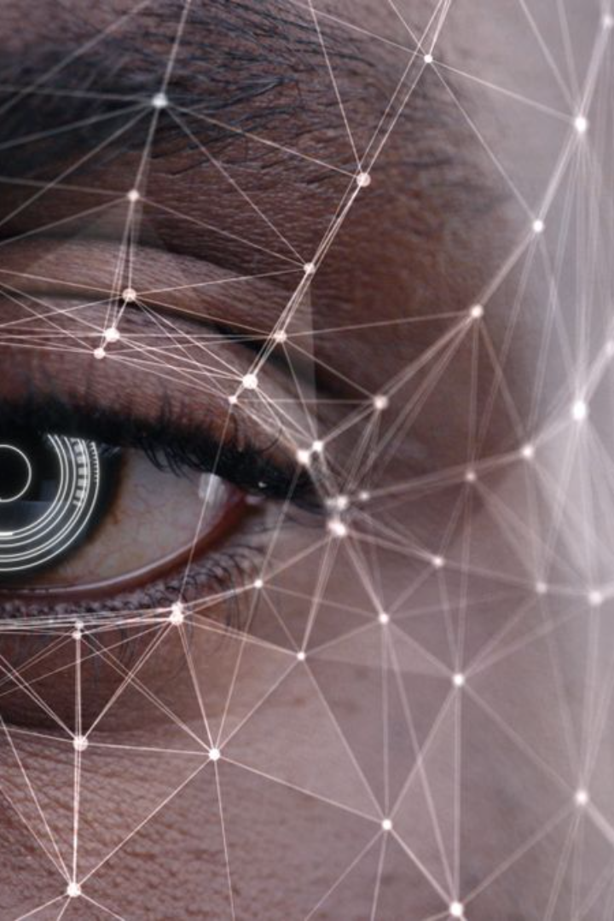
Facial Recognition: A Journey Through PCA and SVD
In this presentation, we delve into the fascinating realm of facial recognition and explore the pivotal role played by Principal Component Analysis (PCA) and Singular Value Decomposition (SVD) in this groundbreaking technology.
Jayan S - 23033
Jagan K S - 23034
Keerthivasan S V - 23037
Krish S - 23040

Slide 2

Introduction
Face recognition is a crucial application in computer vision and image processing with real-world applications such as security systems, authentication processes, and human-computer interaction. Principal Component Analysis (PCA) and Singular Value Decomposition (SVD) are mathematical techniques that offer powerful tools for dimensionality reduction and feature extraction. By employing these techniques, we aim to improve the recognition performance of facial recognition systems, making them more adaptive and resilient to variations in facial expressions, lighting conditions, and other environmental factors.

Slide 3
Objective
The primary objective of this project is to implement and evaluate the effectiveness of face recognition using Principal Component Analysis (PCA) and Singular Value Decomposition (SVD).
Specific goals include: ​
Understanding the theoretical foundations of PCA and SVD in the context of face recognition. ​
Implementing a facial recognition system using these mathematical techniques. ​
Evaluating the performance of the system in terms of accuracy, speed, and robustness. ​

Slide 4
Scope
This project delves into the mathematical heart of face recognition, leveraging the power of Principal Component Analysis (PCA) and Singular Value Decomposition (SVD) to extract key features and reduce data complexity.
PCA is used to reduce the dimensions of a matrix, by identifying and quantifying how much each dimension contributes to the result, allowing only the significant dimensions to be considered.
SVD is used to reduce the size of an image, through compression, improving processing speed and efficiency.
While the theoretical foundation is paramount, the project bridges the gap to practical implementation, translating these principles into functional code using appropriate programming languages and tools. In essence, it's a journey from mathematical elegance to real-world application.

Slide 5
Literature Review :
Research Paper explaining the theory behind using PCA for face recognition: https://www.researchgate.net/publication/318362885_Face_recognition_using_principal_component_analysis_method
Article explaining the origin of the implementation of PCA for face recognition:
https://machinelearningmastery.com/face-recognition-using-principal-component-analysis/
Article demonstrating each step of the process of face recognition using matrices:
https://www.geeksforgeeks.org/ml-face-recognition-using-eigenfaces-pca-algorithm/
YouTube video demonstrating each step of the process of face recognition using matrices with examples:
https://youtu.be/61NuFlK5VdU?si=khH2kzxI_AT5zPZb
GitHub repository containing python code for face recognition, albeit using the webcam of a computer for real time application:
GitHub - gadm21/Face-recognition-using-PCA-and-SVD: In this project, facial recognition algorithm is implemented with python using PCA and SVD dimensionality reduction tools.
AI such as ChatGPT, Bard, and Bing for researching required libraries and their documentation

Slide 6
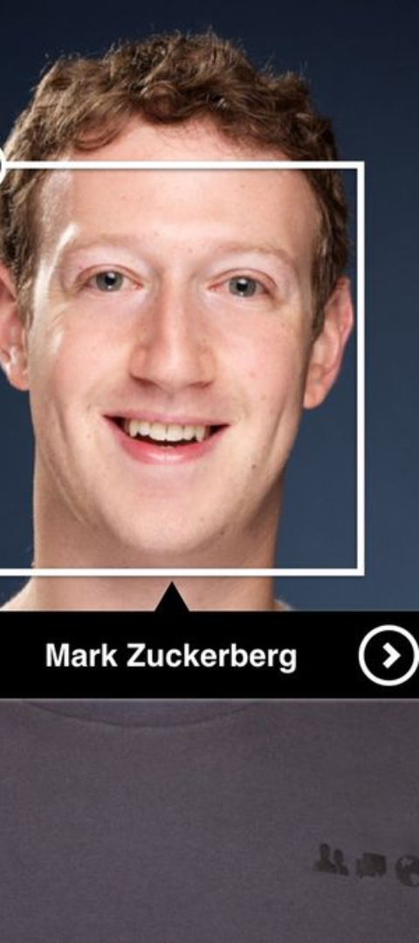
Methodology
Data Collection: Gather a mix of different face pictures with various expressions, lighting, and poses for a strong facial recognition system.​
Preprocessing: Make the pictures better by adjusting their size, brightness, and turning them into black and white.​
Feature Extraction: Use PCA and SVD to pick out important information from the pictures, making it easier for the computer to recognize faces.​
Feature Comparison: Look at the features we found and compare them to features from other face pictures. See how different they are.​
Identification:: Identify the identity of the individual in the facial image by evaluating the obtained feature difference and selecting an identity if the difference is below the threshold value.​ ​
.

Slide 7
Implementation
The implementation phase involves translating the theoretical concepts into a functional face
recognition system.
Key steps in the implementation process include: ​ ​ Coding: Implement PCA and SVD algorithms using a programming language such as Python,
leveraging libraries like NumPy and scikit-learn for efficient computation.​ ​ Integration: Integrate the implemented algorithms into a cohesive face recognition system,
incorporating necessary modules for data input and pre-processing. ​ ​ Testing and Debugging: Rigorously test the system on different subsets of the dataset, identifying
and resolving any issues related to accuracy, speed, or robustness. ​ ​ Optimization: Fine-tune the system parameters and algorithms to optimize its performance,
ensuring a balance between accuracy and computational efficiency.

Slide 8
Project Progress
The milestones of the project include:
Dataset Acquisition
Data Preprocessing
Implementation of PCA and SVD
Feature Extraction
Debugging
Testing and Evaluation
Optimization
The only task yet to be completed is the optimization of the program itself

Slide 9
Contributions
JAYAN S (23033): - Researching prerequisite topics and methods of implementation. Contributed to coding part of taking coefficients of eigenvectors and compilation into matrix. ​
JAGAN K S (23034): - Helped in coding part of representing training image as linear combination of top 150 eigen vectors. ​
KEERTHIVASAN S V (23037): - Collaborated in researching in parts of the project and contributed to coding part of finding the average face vectors of images and compilation of matrix. ​
KRISH S (23040): - Helped in the coding part of the project by contributing to reducing dimensions of matrix and finding the covariance matrix.

Slide 10
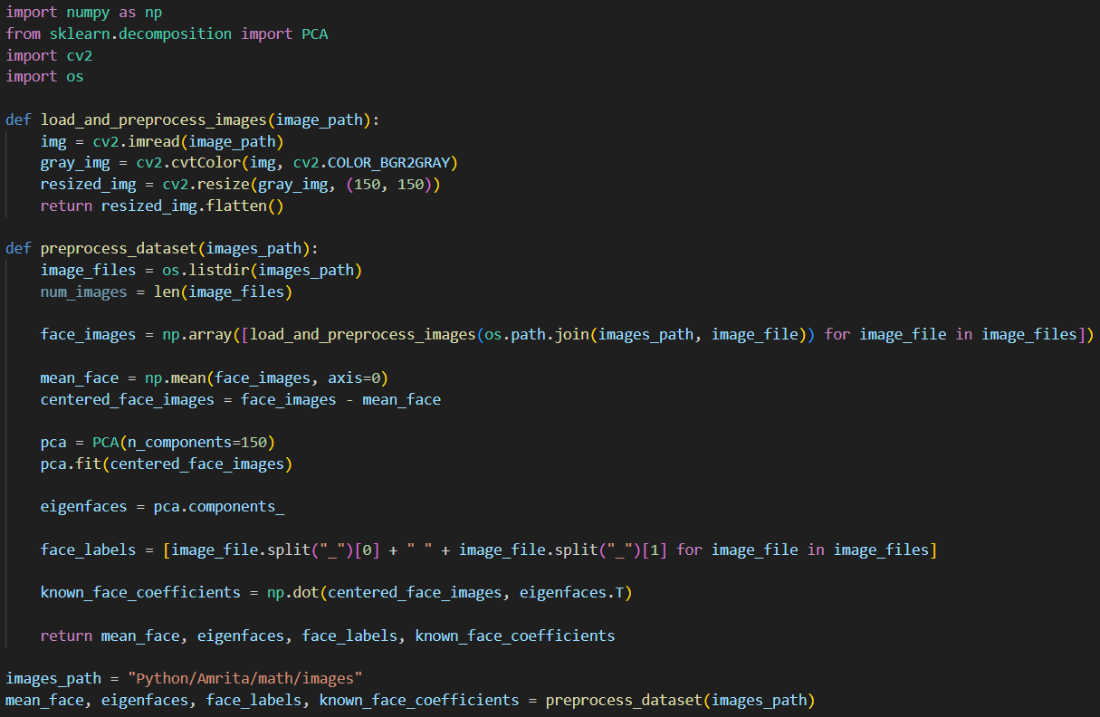
Code – Preload File

Slide 11
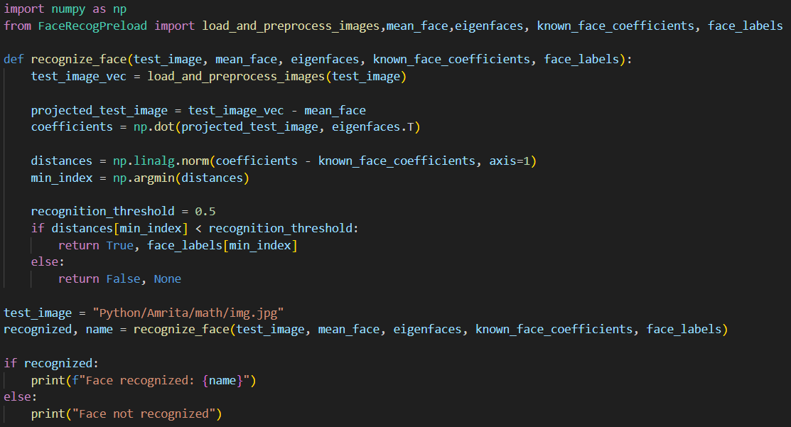
Code – Recognition File

